Slide 1


IT4043E
Big Data
Storage & Processing
GROUP
4
TAXI TRIP ANALYSIS SYSTEM FOR NYC TLC YELLOW TAXI RECORDS

Slide 2



Problem Overview
Motivation & Problem Definition

Slide 3
Defining features of our problem
Dataset
NYC TLC Yellow Taxi Trip Records
Millions of trips / year for 17 years (2009 – present)
Motivation
Understand city-wide taxi demand patterns
Optimize routes, fares, fleet allocation
Applying Big Data storage & processing techniques
Monthly NYC TLC Taxi Data publicly avaliable on https://www.nyc.gov/site/tlc/
Problem Definition
Design and implement a scalable data-processing architecture capable of ingesting, storing, and analyzing NYC Taxi Trip data to extract useful statistics and insights in real time or near-real time.

Slide 4
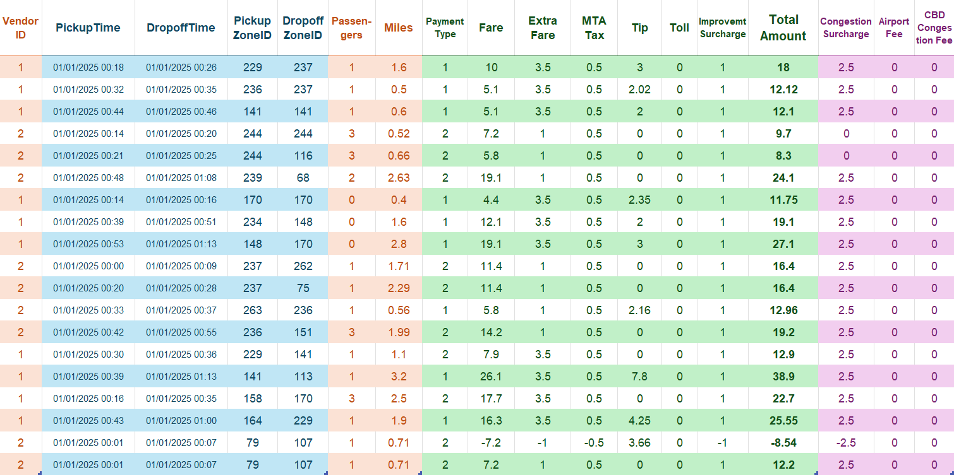
Dataset Description
Figure 2
Sample Data Points from the NYC TLC Yellow Taxi Trip Records
Pickup & Dropoff
Trip
Fares & Fees
Other Fees

Slide 5
Dataset Description
Pickup & Dropoff
Includes Date, Time and Location (Zone ID)

Slide 6
Dataset Description
Trip Info
Includes Number of Passengers and Miles Travelled

Slide 7
Dataset Description
Fare & Fees
Includes Payment Information, Fare and various Fees

Slide 8
Dataset Description
Other Fees
Includes Miscancellaneous Fees

Slide 9
Dataset Coverage & Qualitative Analysis
Dataset Coverage
Temporal: January 2009 – Present (by month)
Spatial: All five boroughs of New York City
Granularity: Each file (~55MB) contails millions of trip-level records
Format: Parquet files We will simulate real-time events and perform analysis on a subset of this dataset.
Qualitative Features
High volume (hundreds of millions of rows) – ideal for distributed storage like HDFS.
Continuous velocity (can simulate real-time ingestion) – fits Kafka streaming.
Diverse variety (categorical, numerical, temporal data) – good for multi-perspective analytics.
High veracity (official, regulated data) – reliable for decision-making.

Slide 10
Proposing Practical Business Questions to be Solved
Business Question | Why It Matters | Data Needed | How We Will Answer It
What are the demand patterns (pickup counts, distances, passenger counts) across time and location? | Understand traffic peaks, identify high-demand zones, support resource allocation. | Pickup timestamps, zones, trip distance, passenger count. | Aggregate trips per time window + zone → store hourly/daily summaries in Cassandra → Grafana visualizes heatmaps, time-series, top-N zones.
Which zones, vendors, or hours contribute most to revenue and profitability? | Helps identify profitable operations, surge periods, and vendor performance. | Fare amount, extra fees, vendor ID, pickup/dropoff location/time. | Spark computes revenue per zone/vendor/time window → Cassandra stores aggregated revenue tables → Grafana plots top vendors, revenue trends, and zone profitability.
Are there operational inefficiencies or anomalies (e.g., unusually long trips, delays, abnormal behaviors)? | Detects potential issues such as routing problems, driver anomalies, or unusual spikes. | Trip duration, trip distance, timestamps, potentially speed-derived metrics. | Spark flags outliers via simple thresholds (e.g., long duration per mile) → Cassandra stores anomaly counts → Grafana shows alerts, anomaly timelines.

Slide 11
Architecture & Design
Components and Data Pipeline

Slide 12

Implementation Details
A Close-up View of Each Component

Slide 13
Demonstration
Showcasing Our Dashboard

Slide 14
Components Overview
Layer | Technology | Purpose
Message Queue | Apache Kafka | Simulate and ingest trip events
Batch Processing | Spark Batch (PySpark) | Periodic data aggregation from HDFS
Streaming Processing | Spark Structured Streaming | Real-time analytics from Kafka
Distributed Storage | HDFS | Store raw and curated historical data
Database | Cassandra (NoSQL) | Store aggregated results for live querying
Visualization | Grafana | Live + static dashboards

Slide 15
Components Overview
Layer | Technology | Purpose
Message Queue | Apache Kafka | Simulate and ingest trip events
Streaming Processing | Spark Structured Streaming | Real-time analytics from Kafka
Distributed Storage | HDFS | Store raw and curated historical data
Database | Cassandra (NoSQL) | Store aggregated results for live querying
Visualization | Grafana | Live + static dashboards

Slide 16
Data Pipeline Summary
Stage | Input | Processing
Ingestion | TLC Yellow Taxi CSV/Parquet | Kafka producer simulates streaming
Batch Layer | HDFS (raw zone) | Spark Batch (aggregations, caching, joins)
Stream Layer | Kafka topic | Spark Streaming (watermark, UDF, window ops)
Visualization | Cassandra/HDFS | Grafana dashboard

Slide 17





Architecture Diagram
Data Source
Real-time Streaming
Serving Layer

Slide 18



Architecture Diagram – Lambda Architecture
Data Source
Speed Layer
Batch Layer
Stream
Raw Dump
Hadoop HDFS
Aggregates
Read
Spark Batch
JSON
Correct
Query
Trigger
Data Source
Scheduler
Notes:
Real-Time Streaming/Ingestion Layer
This layer sits closest to the data source and is responsible for ingesting (and often buffering) large volumes of event/stream data in real time or near-real time. It decouples the producers of data from the processors, provides durability, ordering/partitioning, and makes data available to downstream systems. It also enables re-play of data, back-pressure handling, and helps provide a reliable foundation for streaming analytics. For example, you might capture clickstreams, sensor data, transactions, logs, etc. Uses of this layer:
Buffering, partitioning, persisting streaming events so they aren’t lost if downstream slows.
Providing a streaming log/topic abstraction from which processing engines consume.
Enabling multiple downstream consumers (fan‐out) or replay/debug.
Enabling ingestion from disparate sources into a unified stream platform.

Slide 19
Project Progress So Far
1. Core System Infrastructure Setup
Containerized the development environment using Docker.
Configured local services to run and communicate within the Docker-based environment.
2. Data Pipeline Prototype Development
Built a minimal end-to-end working prototype of the pipeline.
Kafka: Implemented producer and consumer to simulate streaming data flow.
Spark: Conducted initial transformations to validate batch/stream processing logic.
Cassandra: Designed and tested a basic schema for storing processed records.
3. Monitoring & Visualization Setup
Created an initial Grafana dashboard to visualize pipeline metrics and output.
Integrated Grafana with the underlying data source for real-time updates.

Slide 20
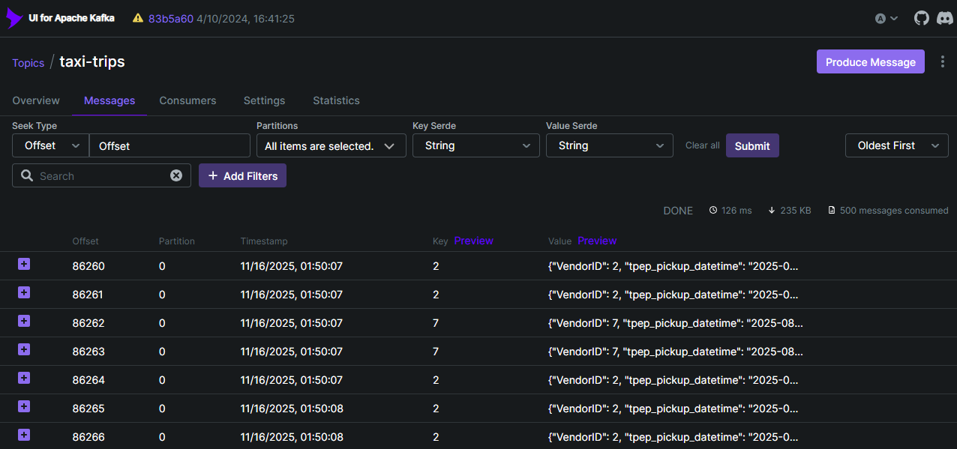
Demonstration of our Work

Slide 21
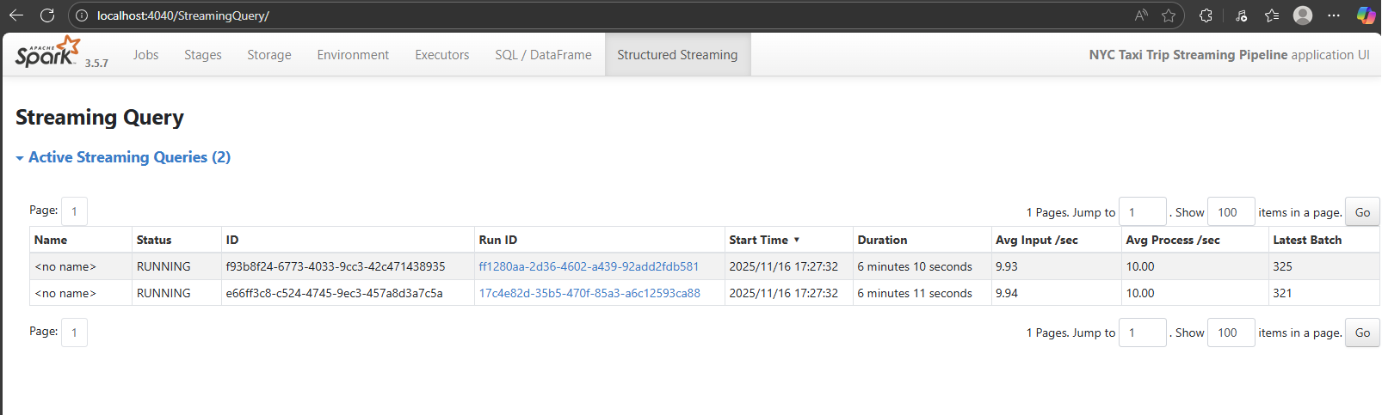
Demonstration of our Work

Slide 22
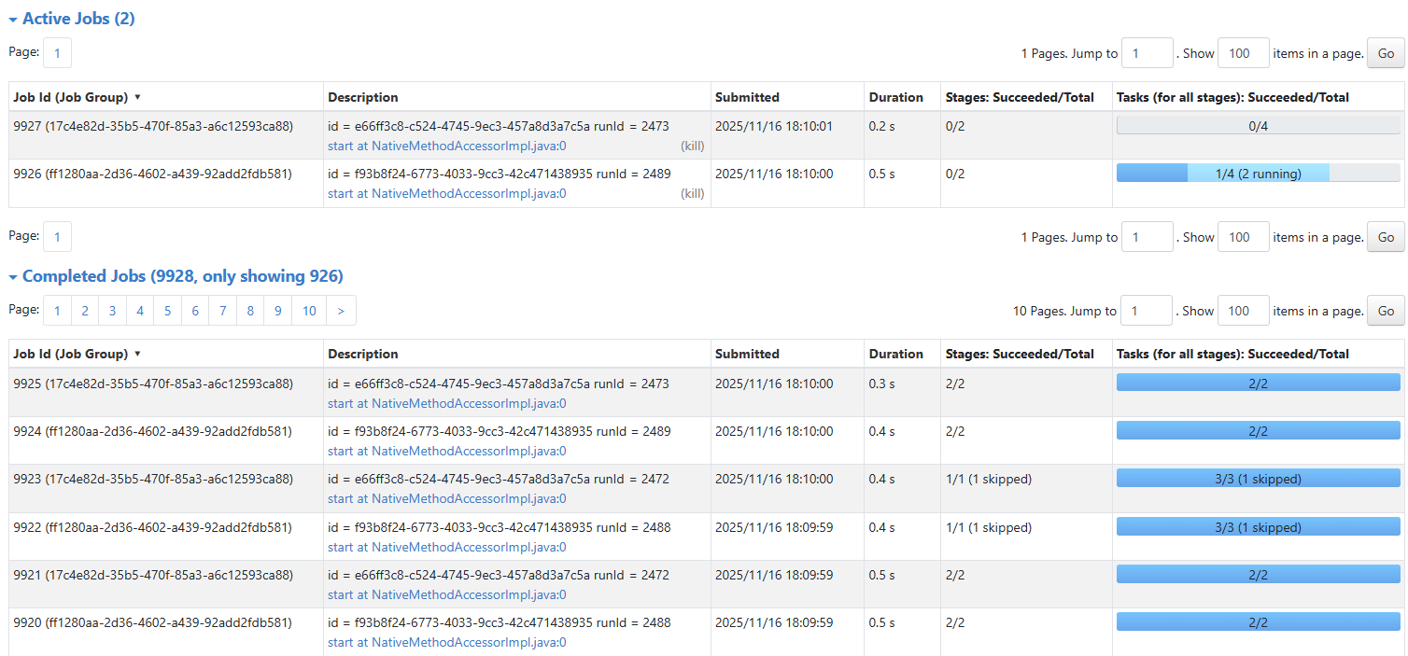
Demonstration of our Work

Slide 23
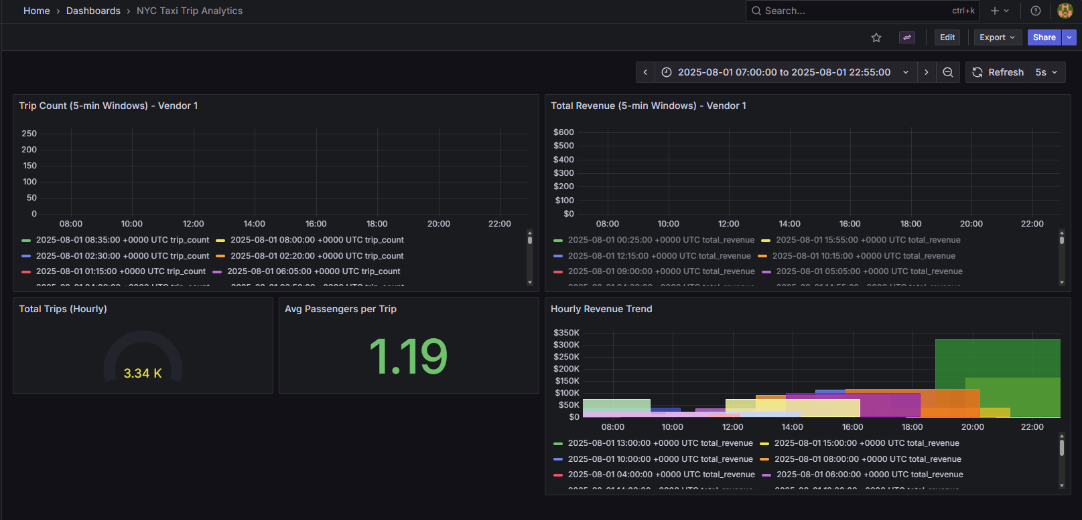
Demonstration of our Work

Slide 24
Components Overview
1. Finalize Data Modeling & Integration
Define Cassandra table schemas aligned with business questions.
Implement Spark → Cassandra write pipelines (batch & streaming).
Validate schema correctness with small-scale test writes before full ingestion.
2. Expand Analytics & Aggregation Logic
Implement full aggregation workflows (revenue, demand patterns, anomalies).
Optimize Spark transformations for throughput and stability.
Add windowed aggregations and zone-level metrics based on final requirements.
3. Complete Dashboard & Visualization Integration
Connect Grafana to the finalized Cassandra datasource.
Build dynamic and drill-down dashboards for each business question.
Implement visual alerts (e.g., anomaly spikes, peak demand periods).

Slide 25
Thank you!

